Slide 1


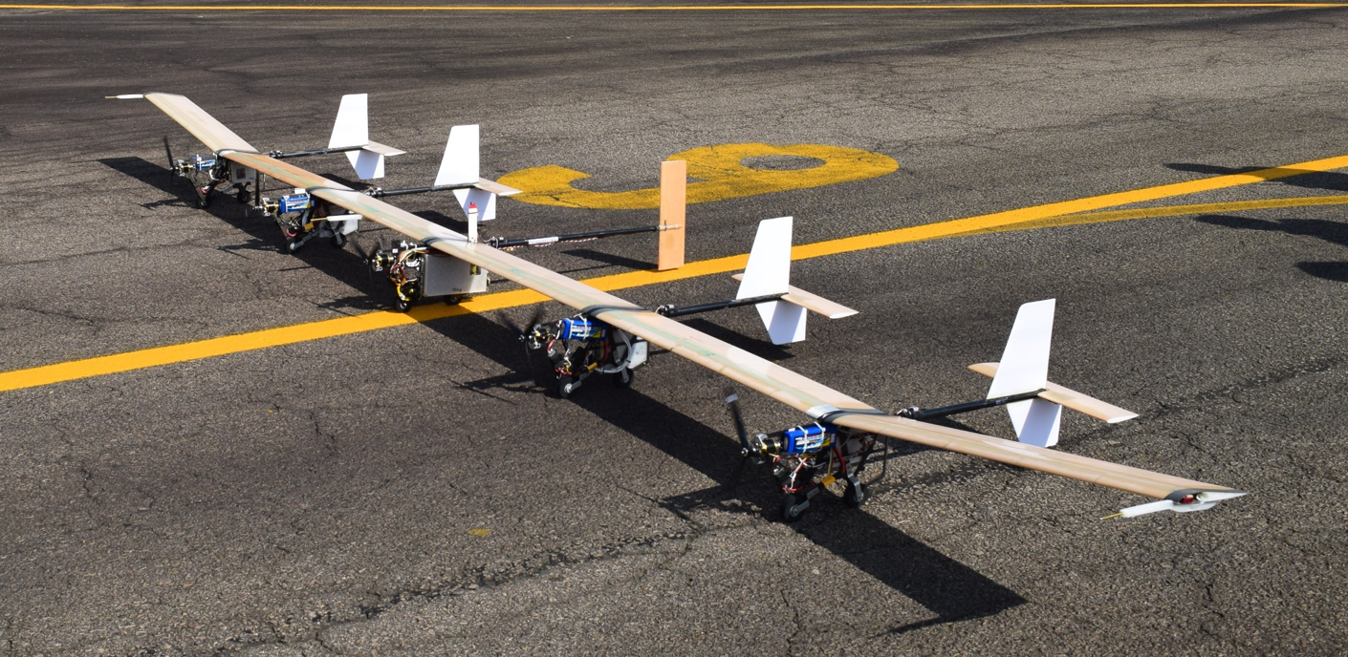
Aeroelastic Analysis and Optimization of a Highly Flexible Aircraft
Francisco Arthur Bonfim Azevedo
Tutor: Joseph Morlier
29/06/2020
Notes:
Bonjour, Good morning, my name is Francisco Arthur and I will present you my PIR about an Aeroelastic analysis and optimization of a highly flexible aircraft

Slide 2

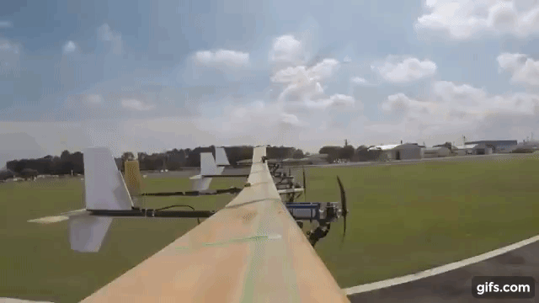
What is a highly flexible aircraft
Notes:
But before I begin to talk about my project, I will talk a little about what is a Highly flexible aircraft, so it will be easier for you to have a image of what I am talking about

Slide 3
What is a highly flexible aircraft
Suffer of great deformations of the wing during the flight (>10% of the wingspan);
It is much lighter than other aircraft that have the same configuration, but are more rigid.¹
Notes:
Read
Actually, it may suffer great deformations in other parts then the wing, but in this project we will limit ourselves to a wing analysis
Read
One of its great advantages is the low weight

Slide 4

What is a highly flexible aircraft
Notes:
Now I will show you a forty seconds video of the flight of a brazilian highly flexible wing of my former university that is the main inspiration of this work
Start: 1:08 -> 1:35
Jump to: 1:45 -> :1:55

Slide 5
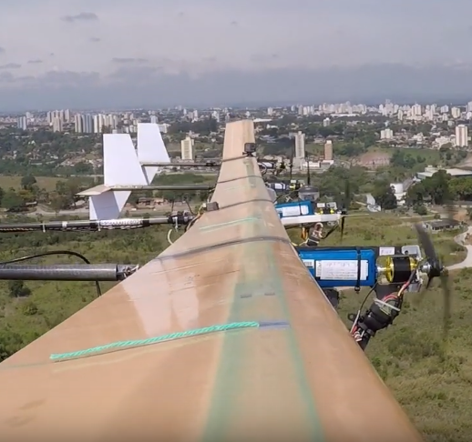
The goals of the project
Notes:
And now I will talk about the present project and its goals

Slide 6
The goals of the project
Develop a mathematical/physical model of the aeroelastic properties of the highly flexible wing, coded in python 3.5
Propose an optimization problem based in the aeroelastic model, aiming to increase the flutter speed and decrease the aircraft mass, without removing its flexible characteristics
Notes:
The two main goals of this project are:
Read
Read
This can give you an ideia about the two main phases of the problem: the aeroelastic problem and the optimization problem

Slide 7
The Aeroelastic problem
Notes:
To start understanding the hole project, lets start talking about its physics: the aeroelastic problem

Slide 8
The Aeroelastic problem
As the literature¹ ² ³ ⁴ previews, the model is a nonlinear coupled one.
There are different mathematical models for this problem, with different approaches, but the one chosen for the present work is the one by Ribeiro et al^{3.}
In his work, a nonlinear beam model for large displacements was applied to represent the structural dynamics combined with the strip theory for the aerodynamics, including three bidimensional modeling approaches: a quasi-steady, a quasi-steady with apparent mass and a full unsteady.
Notes:
Read
Read
The model adopted is the same of the project of the aircraft that I previously had shown to you
Read
That will be the same considerations that will be used, except that only the full unsteady model was used, as I will talk later

Slide 9
The Aeroelastic problem
The motivations to chose this model:
Come with a Matlab’s Toolbox (AeroFlex Toolbox);
Recent and updated work (2012);
It has very precise results in comparison with other works and experimental data;
It is possible to take out some functionalities of the toolbox to simplify the study.
Notes:
Read
So it will be easier to code some more complex parts of the code
Read
Read
Read
And in this case we want to simplify the things because our main focus is the optimization

Slide 10
The aeroflex toolbox
Notes:
And now I will talk a little about the AeroFlex toolbox

Slide 11
The aeroflex toolbox
Flexible Wings
Aeroelastic Analysis
Rigid Wings
AeroFlex
It is possible to chose between some aerodinamic models
A really complete tool for modelling flexible aircrafts, including aeroelastic analysis, flight dynamics, and other functionalities.
Flight Dynamics
The aeroelastic model will be used with less options for the user, to simplify the initial work.
Notes:
First of all we have the AeroFlex toolbox
Read
Pass
And its functionalities
Read
But we want to simplify it, so
Pass
We will only use the aeroelastic analysis of flexible wings in this work

Slide 12
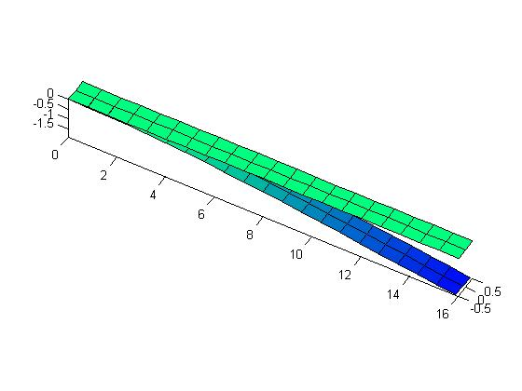
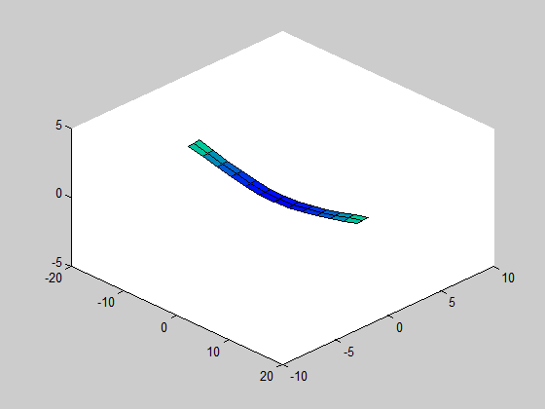
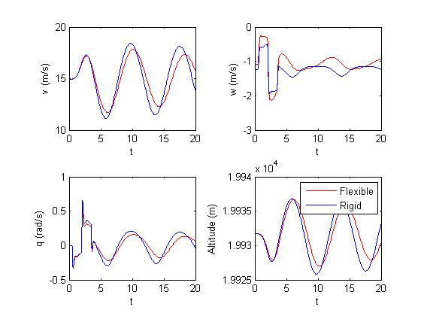
The aeroflex toolbox
Notes:
Here we have some outputs of the aeroflex
Here we have the representation of a wing bending and its tip displacement,
Here we have the analysis of the aircraft during the flight, as its velocity and altitude, and here the visual representation of it

Slide 13
The Aeroelastic model
Notes:
And know I will talk about the aeroelastic model

Slide 14
The Aeroelastic model: Structure dynamics
The equations that describes the structure dynamics:
$\left[\begin{matrix}M_{FF} & M_{FB} \\ M_{BF} & M_{BB}\end{matrix}\right]\left[\begin{aligned}\ddot{ε} \\ \dot{β}\end{aligned}\right]$+$\left[\begin{matrix}C_{FF} & C_{FB} \\ C_{BF} & C_{BB}\end{matrix}\right]\left[\begin{aligned}\dot{ε} \\ β\end{aligned}\right]$+$\left[\begin{matrix}K_{FF} & 0 \\ 0 & 0\end{matrix}\right]\left[\begin{aligned}ε \\ \vec{b}\end{aligned}\right]=\left[\begin{aligned}R_{F} \\ R_{B}\end{aligned}\right]$
$\left[\begin{aligned}R_{F} \\ R_{B}\end{aligned}\right]$ = $\left[\begin{aligned}J_{pε}^{T} \\ J_{pb}^{T}\end{aligned}\right]F^{pt}+\left[\begin{aligned}J_{θε}^{T} \\ J_{θb}^{T}\end{aligned}\right]M^{pt}$+$\left[\begin{aligned}J_{pε}^{T} \\ J_{pb}^{T}\end{aligned}\right]B^{F}F^{dist}$+$\left[\begin{aligned}J_{θε}^{T} \\ J_{θb}^{T}\end{aligned}\right]B^{M}M^{dist}$+$\left[\begin{aligned}J_{hε}^{T} \\ J_{hb}^{T}\end{aligned}\right]N\vec{g}+\left[\begin{aligned}0 \\ R_{RB}^{ext}\end{aligned}\right]$
Notes:
Here we have the main equation of the structure dynamics. The coefficients are really complex, and to show then is not the main focus of the presentation, they are in the paper, so I will show you just how they work. Each J here is a jacobian matrix. This equation comes from the principle of the virtual work

Slide 15

The Aeroelastic model: Aerodynamics
The equations of the aerodynamics forces and momentum:⁵
$\left\{\begin{aligned}L= πρb^{2}\left(−\ddot{z}+\dot{y}\dot{α}−d\ddot{α}\right)+2πρby^{2}\left[−\frac{\dot{z}}{y}+\left(\frac{1}{2}b−d\right)\frac{\dot{α}}{\dot{y}}−\frac{λ_{0}}{\dot{y}}\right] \\ M=Ld+2πρb^{2}\left(−\frac{1}{2}\dot{y}\dot{z}−\frac{1}{2}d\dot{y}\dot{α}−\frac{1}{2}\dot{y}λ_{0}−\frac{1}{16}b^{2}\ddot{α}\right) \\ D=−ρb{\dot{z}}^{2}C_{d0}\end{aligned}\right.$
Notes:
Read
This model is the unstead one, it comes from the work from Peters. As I said, only the unsteady model was used, to simplify the model and the project. The unsteady was chosen because it is closer to reality, and it has an oscillatory character that is essential for the flutter phenomenon, greatly influencing in the flutter speed.

Slide 16


The Aeroelastic model: Linearized model
The numerical linearization process results in the following space state model:
The eigenvalues of the system come from $M^{−1}A. W$hen the real parte of the eigenvalue is positive, the solution of the system diverges and the flutter phenomenon happens
$M\left[\begin{aligned}\dot{\overline{X}} \\ \dot{\overline{ε}} \\ \dot{\overline{λ}} \\ \dot{\overline{k}}\end{aligned}\right]=A\left[\begin{aligned}\overline{X} \\ \overline{ε} \\ \overline{λ} \\ \overline{k}\end{aligned}\right]+B\left[\begin{matrix}{\overline{δ}}_{u,i} & {\overline{π}}_{i}\end{matrix}\right]$
Notes:
And then we have the linearized model.
Read
The states are: X, first derivative of epsilon, epsilon, that is the vector of deformations, lambda, the lag states, a parameter from the model of peters, and k the vector of kinematics variables representing the angles of bank, pitch, heading and its altitude.
Read
The strategy to find the flutter speed is, iteratively, change the speed of the aircraft and calculate the eigenvalues, until a real part is find in one of it.

Slide 17
The optimization problem
Notes:
And now, with the physical model ready, we can propose and solve the optimization problem

Slide 18
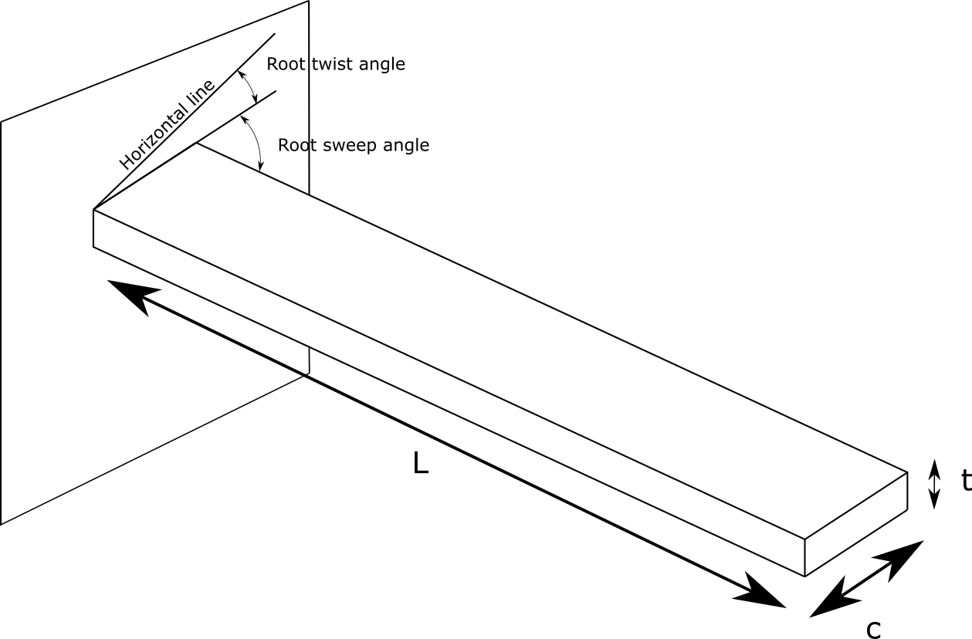
The optimization problem
First of all, a simplified model was created and the design parameters chosen
The model is a flat plate pinned on the left and free on the right, with the parameters:
c, that is equivalent to the wing's chord;
t, the thickness;
L, the half wing span;
the sweep angle in the root and
the twist angle in the root for simplification purpose.
In this model, c>>t and L>>c, so the plate is closer to the reality and the approximations of the theory may be applied.
Optimization was made with the package openMDAO using the algorithm COBYLA⁶
Notes:
Reeeeeeeeeeeead
Only the angles on the root were analyzed to simplify the model
Read
Read
One of the ideas to the future works is to study which algorithm is better to this study. Here we used the COBYLA

Slide 19
The optimization problem
The material chosen for the plate was Aluminum 7075, largely used in the aeronautics industry. It has the following properties:
Young Modulus E = 71.7 Gpa
Shear Modulus G = 29.9 Gpa
Volumetric Density ρ = 2810 Kg/m³
The aerodynamic properties were chosen as follow:
C_{d0} = 0.02
C_{m0} = 0
α₀ = -5π/180
C_{L0} = 2π/180
C_{L,δ} = 0
C_{m,δ} = 0
Notes:
Read
Read
The aerodynamic properties came from experimental data of the X-HALE-BR, combined with data of a flat plat without control surfaces
The real material of the aircraft is glass fiber, but with the actual model, only isotropic materials may be analyzed. This option will be added in future versions of the code

Slide 20



The optimization problem
The optimization problem may be described as the minimization of the following objective function:
V₀ and m₀ are constants to make the problem dimensionless. They were arbitrarily chosen as mean values V₀ = 10 m/s and m₀ = $ρLct$= 2810* 0.5* 0.005*5 = 35.125 Kg
$$J\left(c,t,L,sweep,twist\right)=−\frac{V_{flutter}}{V_{0}}+\frac{m}{m_{0}}$$
$$\left\{\begin{aligned}0.1 m<c<1 m \\ 0.001 m<t<0.05 m \\ 3 m<L<15 m \\ 0°<sweep<10° \\ 0°<twist<10° \\ c>10t \\ Tip displacement>0.15L\end{aligned}\right.$$
Notes:
The optimization was proposed as follow, with the goal of maximize the flutter speed and minimize the mass.
Read
This constraint is a way to guarantee the condition $c>>t$. As $L$ is naturally bigger than $c$ in the chosen range, an additional condition is not necessary. The other conditions were arbitrarily chosen, based on amount of material spent, aerodynamic performance and literature.
As an additional constraint, it is necessary to verify if the wing tip displacement is bigger than $15\%$, so the wing may be considered highly flexible.
Read
It is possible to change this parameters to increase the importance of each term. For example, if we make this term greater, the focus will be in maximize the flutter speed. But as an standard objective function, that worked well, because the terms have almost the same order of magnitude.

Slide 21
The Results
Notes:
And, with all of our tools and models ready, we go to the results

Slide 22
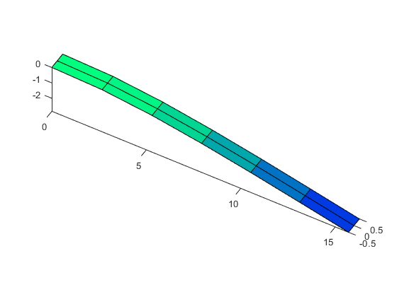
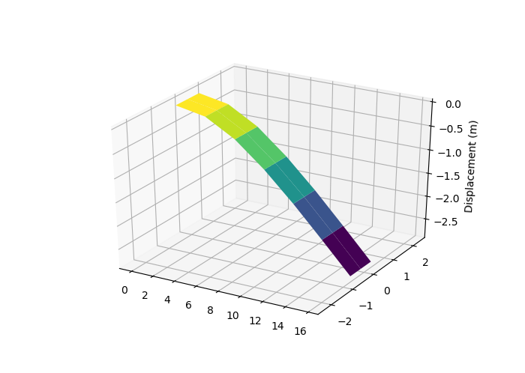
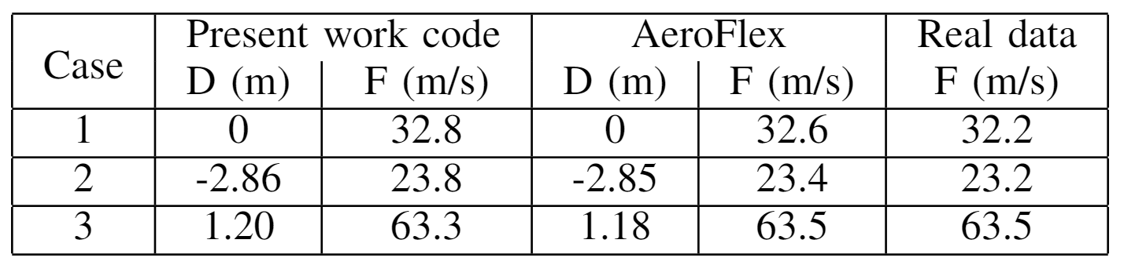
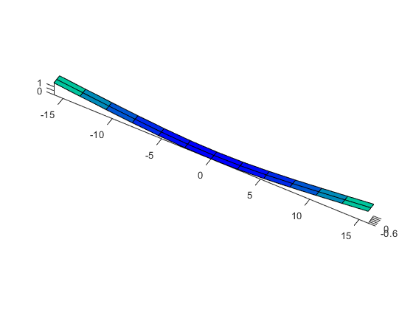
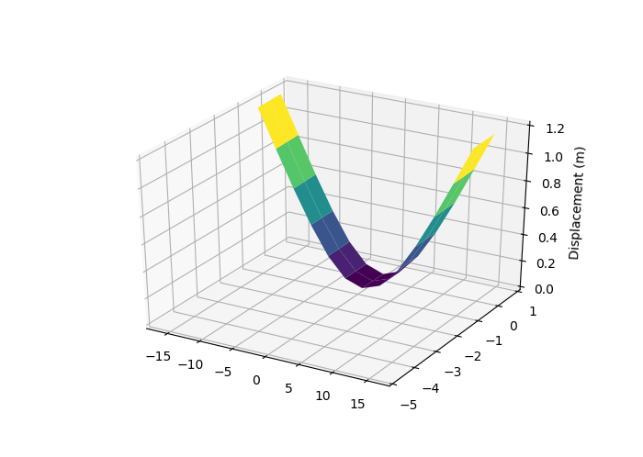
Results of the aeroelastic model
Case 2: AeroFlex
Case 2: Present Work
Case 3: AeroFlex
Case 3: Present Work
Notes:
Here we have a table with the results
D is for deflection of the wing tip
F is for flutter speed
Case 1: Rigid beam pinned in the left, wind speed of10m/s
Case 2: Flexible beam pinned in the left deformed by itsweight, wind speed of 10m/s
Case 3: Free body analysis of a highly flexible flyingwing, flying speed of 10 m/s, wind speed of 0 m/s
Its is possible to see that the results of the code of this work are really accurate with the aeroflex results and the literature present in Ribeiro’s work
Here we have some visual representation of the simulations.
The images of the rigid bar are not here because the deflection is zero, so that are not that interesting, and I preferred to focus on this two cases
The scales of the image from python and matlab are different, but the results are equivalent as may be seen in the table

Slide 23
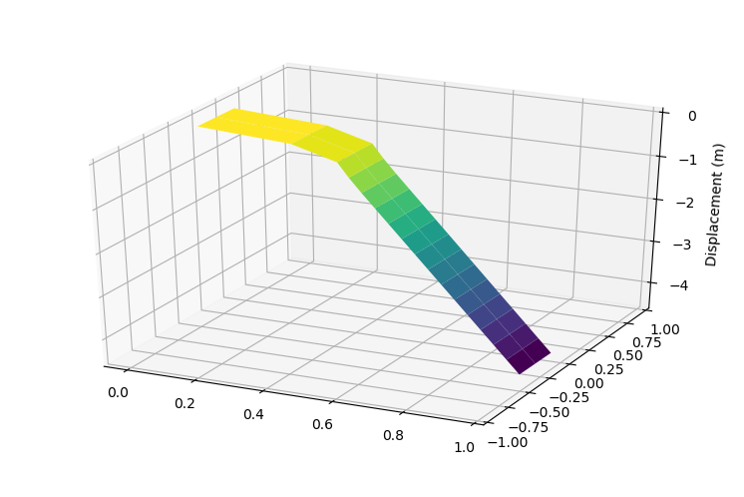
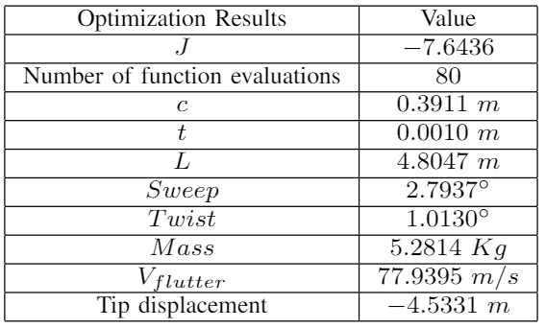
Results of the Optimization
Notes:
Here we have the results of the optimization
Read
Here the visual representation of the deformed plate. Its is possible to notice that the case of study is really similar to the case 2 of the results of the aeroelastic model, and, as expected, they have similar results
Read
As it is possible to see, the results are really satisfactory. This speed is greater than the speed that the X-HALE-BR is capable of reach, so we will have no problems with flutter.

Slide 24
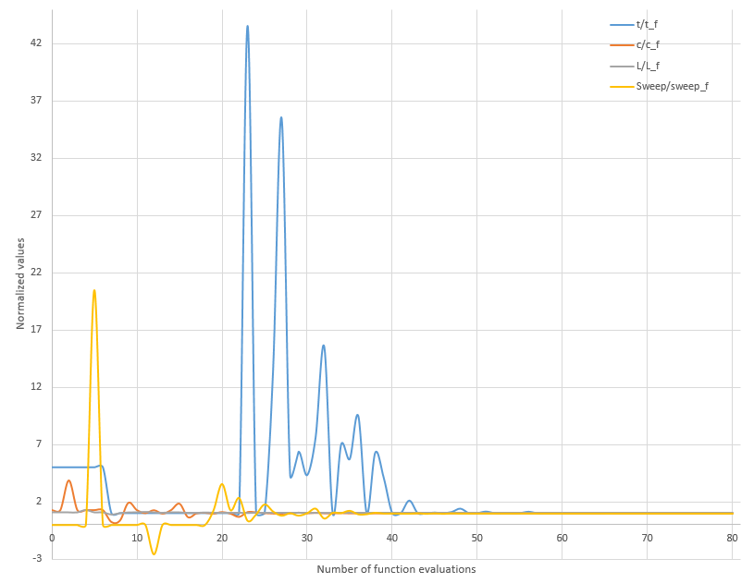
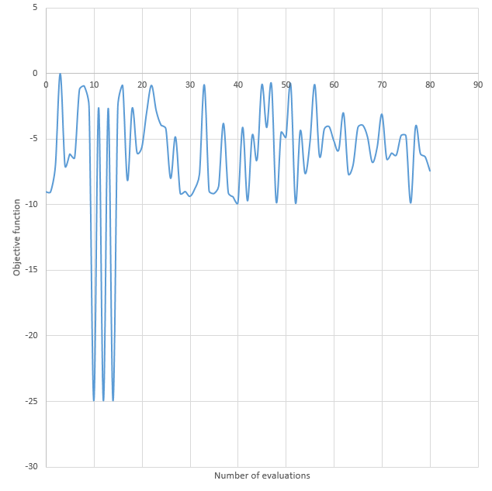
Results of the Optimization
Notes:
Here we have data about the convergence of the optimization
on the left the design variables normalized by its final value,
on the right the value of the objective function in each iteration.
If question: On the right, the values under the final value were not chosen by the algorithm because they did not obeyed the constraints

Slide 25
Conclusion and future work
Notes:
And now, concluding

Slide 26
Conclusion
The aeroelastic model worked as expected and generated precise results that are in accord with the literature
The optimization process in a simplified model generated results in accord with the requisites of the project
All the goals of the project were accomplished

Slide 27
Future work
There are few addictions to improve the project both in the near future and in the far future:
Near Future:
Far future:
Include flight dynamics;
Include composite materials;
Creation of a GUI;
Optimization with different algorithms;
Connect the code with XFOIL;
Increase the complexity of the optimization model
In a far future, it is desired to use the optimized aircraft and the aeroelastic model to design an active flutter suppress controller to greatly improve its resilience against the flutter phenomenon.

Slide 28
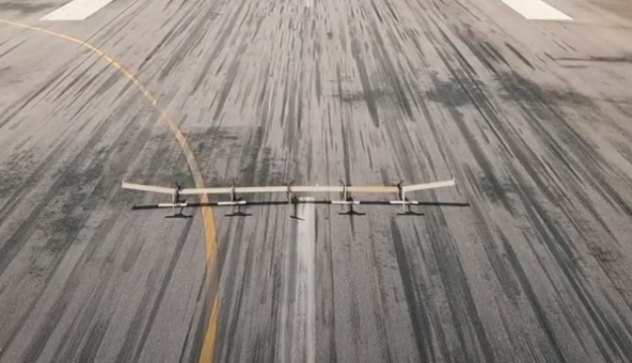
Thank you!
Questions?

